Slide 1



HEAP MEMORY
MANAGER
Presented by: Mohamed Abo khalil

Slide 2
OVERVIEW
01
02
03
why we need heap ?
how allocation occur in stack ?
Algorithms
04
05
Implementation
Problems

Slide 3


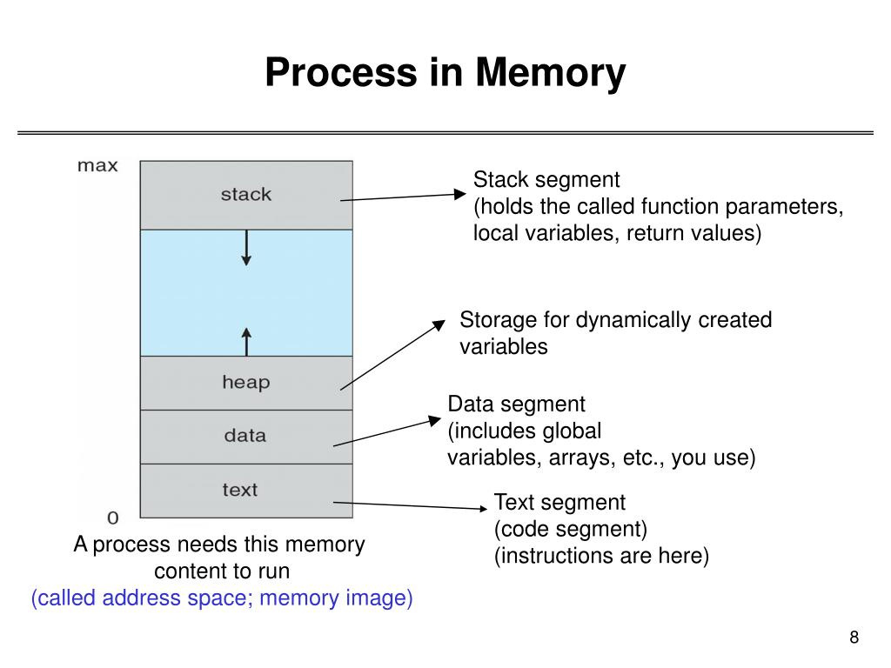


WHY DO WE NEED HEAP ?
Dynamic memory allocation is a programming concept where memory is allocated at runtime rather than compile time. In languages like C and C++, dynamic memory allocation is crucial for tasks where the size of data structures is not known until the program runs or when memory needs to be allocated and deallocated dynamically during program execution.
dynamic memory allocation is typically achieved using functions like malloc, calloc, realloc, and free. These functions allow the programmer to allocate memory from a region of memory at the heap. The heap is a large pool of memory that is available for dynamic allocation.

Slide 4
HOW ALLOCATION OCCUR IN STACK ?
Allocation: When alloca is called, it adjusts the stack pointer by the specified amount to make space for the requested memory within the current stack frame.
The allocated memory can be used just like any other dynamically allocated memory.
You can access and manipulate the allocated memory using the returned pointer
Scope ?
Deallocation ?

Slide 5
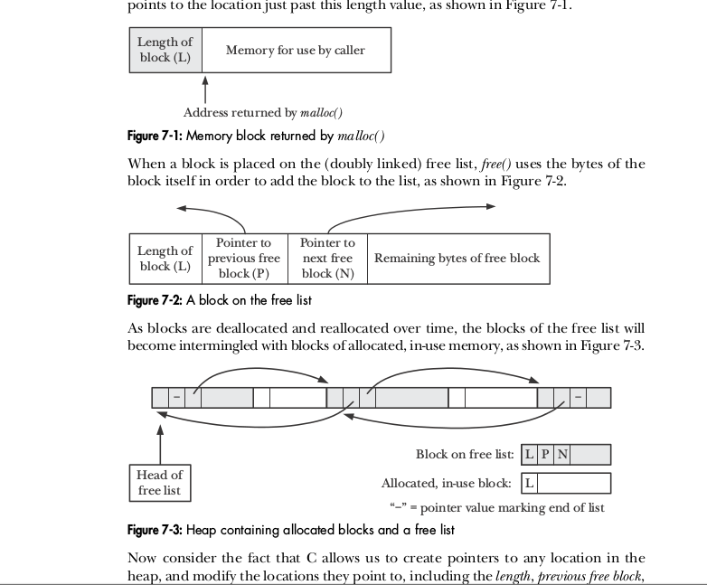
ALGORITHMS
Free List: The free list is a data structure that keeps track of available memory blocks on the heap. When a request for memory allocation is made, the memory manager searches the free list for a suitable block of memory to allocate. When memory is deallocated, it is added back to the free list

Slide 6
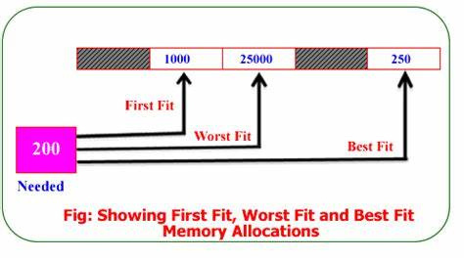
ALGORITHMS
First Fit, Best Fit, and Worst Fit: These are allocation strategies used to choose which free memory block to allocate when fulfilling a request.
there is another allocation
algorithms like buddy allocation.

Slide 7
ALGORITHMS
First Fit is a simple and commonly used memory allocation algorithm due to its efficiency and ease of implementation.
Efficiency: First Fit tends to be efficient in terms of both time and space
Simplicity: The implementation of First Fit is straightforward and easy to understand
Low overhead: First Fit typically has low overhead compared to more complex allocation algorithms
Disadvantage :
Fragmentation: One of the main drawbacks of First Fit is that it can lead to fragmentation, where small gaps of unused memory accumulate between allocated blocks.

Slide 8
IMPLEMENTATION
Dynamic Memory Allocation:
This implementation provides dynamic memory allocation functionality similar to malloc, calloc, and realloc.
Memory Management Data Structure:
The implementation uses a free list data structure to manage available memory blocks. This data structure maintains a list of free memory blocks, allowing efficient reuse of freed memory.
Thread Safety:
Thread safety is ensured using a mutex lock (hmm_mutex). This prevents multiple threads from accessing the memory manager simultaneously, avoiding potential data corruption or race conditions.

Slide 9
IMPLEMENTATION
Memory Alignment:
Memory alignment is enforced by aligning the size of allocated blocks to 8 bytes for 64-bit machines.
Memory Splitting and Merging:
The implementation supports memory splitting and merging to optimize memory usage. When allocating memory, free blocks may be split to accommodate the requested size. Conversely, when deallocating memory, adjacent free blocks may be merged to form larger contiguous blocks.
Heap Management:
The implementation interacts with the underlying heap using sbrk to request additional memory from the operating system when needed

Slide 10
IMPLEMENTATION
Error Handling:
Error handling is implemented to handle various edge cases, such as failed memory allocations
Performance Considerations:
The implementation aims for efficient memory allocation and deallocation operations, considering factors such as time complexity, space complexity, and fragmentation. Techniques like memory splitting, merging, and alignment contribute to optimizing performance.
Minimized MetaData
8 Byte in allocated
24 Byte in free

Slide 11
FUNCTIONS DETAILS
MALLOC
Purpose: Allocates memory.
Parameters:
size: Size of the memory to be allocated.
Return Value: Pointer to the allocated memory.
Algorithm:
Acquires a mutex lock to ensure thread safety.
Determines the size of the memory block to be allocated.
Calls traverse_freelist to find a suitable block or initializes the free list if necessary.
Performance Considerations: Depends on the efficiency of memory allocation and traversal.
Usage Examples: Used to dynamically allocate memory during program execution.

Slide 12
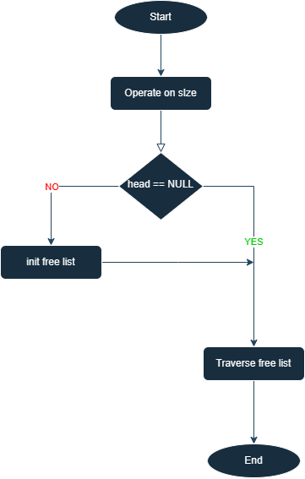

Slide 13
FUNCTIONS DETAILS
INIT_FREELIST
Purpose: Initializes the free list data structure.
Parameters: None.
Return Value: Returns 0 on success, -1 on failure.
Algorithm:
Allocates memory for the head node using sbrk.
Initializes the head node with the allocated memory size and pointers.
Error Handling: Checks if sbrk returns -1 to indicate failure.
Performance Considerations: This function's performance depends on the efficiency of the memory allocation mechanism.
Usage Examples: Typically called at program startup to initialize the memory management system.

Slide 14
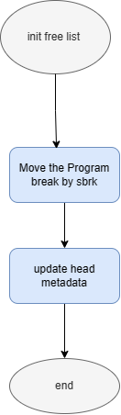

Slide 15
FUNCTIONS DETAILS
TRAVERSE_FREELIST
Purpose: Traverses the free list to find a suitable block for allocation.
Parameters:
node: Pointer to the starting node of the list.
needed_size: Size needed for allocation.
Return Value: Pointer to the allocated node.
Algorithm:
Iterates through the free list to find a block of sufficient size.
Performance Considerations: Depends on the size and structure of the free list.
Usage Examples: Called by malloc to find and allocate memory blocks.

Slide 16
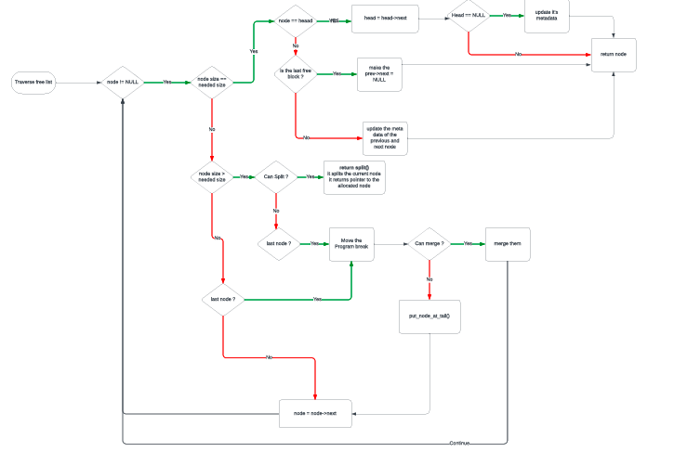

Slide 17
FUNCTIONS DETAILS
SPLIT
Purpose: Splits a free node into two nodes.
Parameters:
node: Pointer to the node to be split.
needed_size: Size needed for allocation.
Return Value: Pointer to the allocated block.
Algorithm:
Splits the node into two if there's enough space.
Performance Considerations: Depends on the size of the free block being split.
Usage Examples: Used when allocating memory of a specific size.

Slide 18
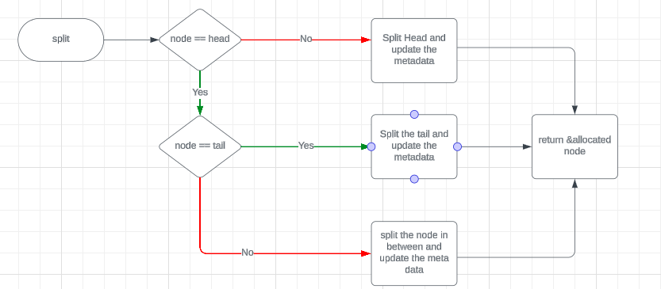

Slide 19
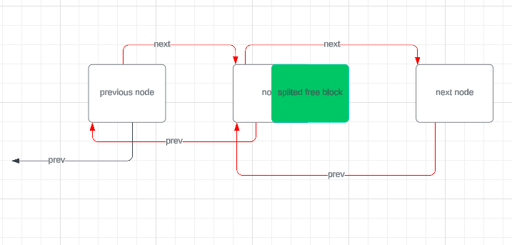

Slide 20
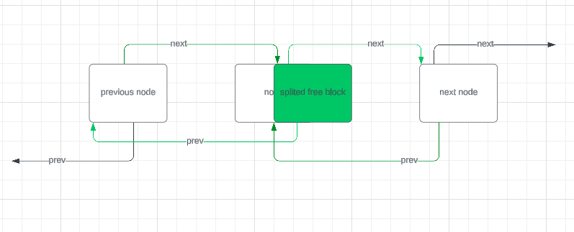

Slide 21
FUNCTIONS DETAILS
FREE
Purpose: Frees allocated memory.
Parameters:
ptr: Pointer to the memory to be freed.
Algorithm:
Acquires a mutex lock to ensure thread safety.
Adds the freed memory block to the free list and merges adjacent free blocks if necessary.
Performance Considerations: Depends on the size and structure of the free list.
Usage Examples: Used to release dynamically allocated memory.

Slide 22
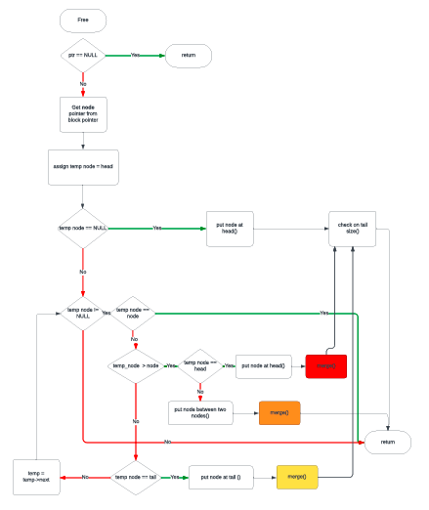

Slide 23
FUNCTIONS DETAILS
PUT_NODE_AT_HEAD
Purpose: Adds a node to the head of the free list.
Parameters:
node: Pointer to the node to be added.
Algorithm:
Adjusts pointers to insert the node at the beginning of the list.
Performance Considerations: Constant time complexity as it involves updating pointers only.
Usage Examples: Used when a new memory block becomes available for reuse.

Slide 24
FUNCTIONS DETAILS
PUT_NODE_AT_HEAD
Purpose: Adds a node to the head of the free list.
Parameters:
node: Pointer to the node to be added.
Algorithm:
Adjusts pointers to insert the node at the beginning of the list.
Performance Considerations: Constant time complexity as it involves updating pointers only.
Usage Examples: Used when a new memory block becomes available for reuse.

Slide 25
FUNCTIONS DETAILS
PUT_NODE_BETWEEN_TWO_NODES
Purpose: Adds a node between two nodes in the free list.
Parameters:
node: Pointer to the node to be added.
next_node: Pointer to the next node in the list.
Algorithm:
Adjusts pointers to insert the node between node and next_node.
Performance Considerations: Constant time complexity.
Usage Examples: Used when splitting a memory block to create a new free block.

Slide 26
FUNCTIONS DETAILS
PUT_NODE_AT_TAIL
Purpose: Adds a node at the tail of the free list.
Parameters:
node: Pointer to the node to be added.
tail: Pointer to the tail of the list.
Algorithm:
Adjusts pointers to insert the node at the end of the list.
Performance Considerations: Constant time complexity.
Usage Examples: Typically used when extending the heap to allocate new memory blocks.

Slide 27
FUNCTIONS DETAILS
MERGE
Purpose: Merges two free nodes.
Parameters:
left_node: Pointer to the left node.
right_node: Pointer to the right node.
Algorithm:
Combines adjacent free nodes into a single larger node.
Performance Considerations: Constant time complexity.
Usage Examples: Used to merge adjacent free memory blocks after deallocation.

Slide 28
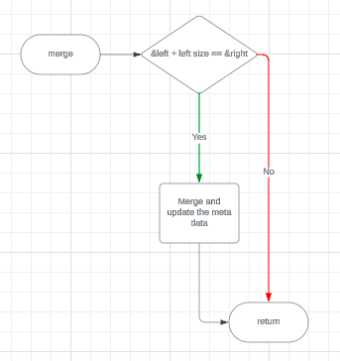

Slide 29
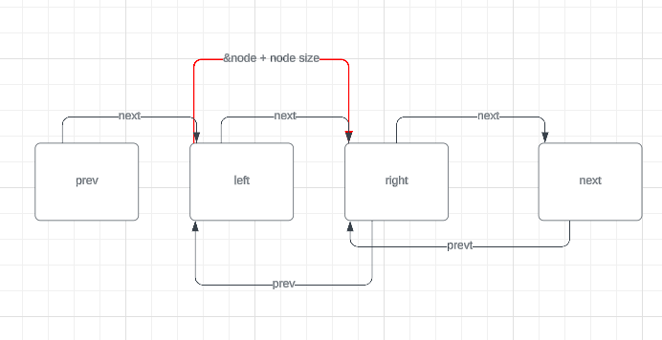

Slide 30
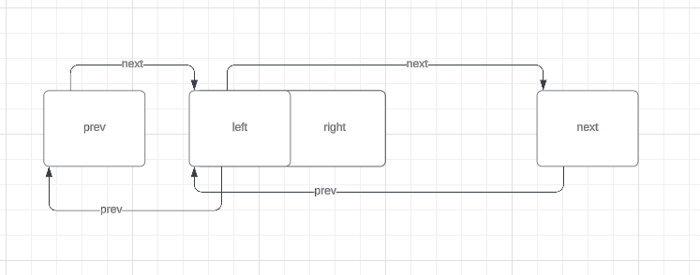

Slide 31
FUNCTIONS DETAILS
CHECK_ON_TAIL_SIZE
Purpose: Checks if the size of the tail node is sufficient to release memory.
Parameters:
tail: Pointer to the tail node.
Algorithm:
Checks if the size of the tail node exceeds a certain threshold for releasing memory.
Performance Considerations: Constant time complexity.
Usage Examples: Used to release memory when the tail node size is large enough.

Slide 32
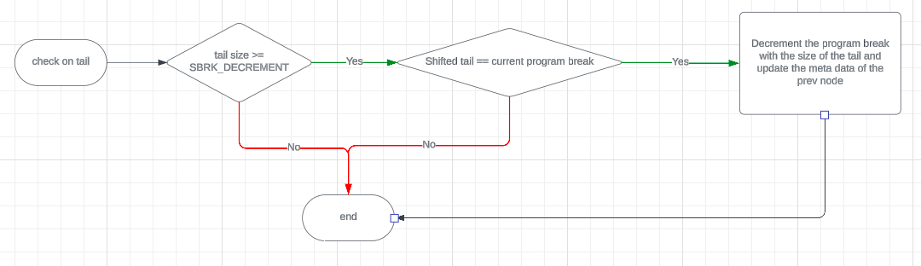

Slide 33
FUNCTIONS DETAILS
CALLOC
Purpose: Allocates memory initialized to zero.
Parameters:
nmemb: Number of members.
size: Size of each member.
Return Value: Pointer to the allocated memory.
Algorithm:
Calls malloc to allocate memory and memset to initialize it to zero.
Performance Considerations: Depends on the efficiency of memory allocation and initialization.
Usage Examples: Used to allocate and initialize memory for arrays or structures.

Slide 34
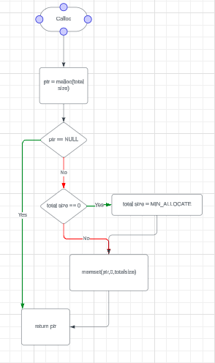

Slide 35
FUNCTIONS DETAILS
REALLOC
Purpose: Reallocates memory.
Parameters:
old_ptr: Pointer to the previously allocated memory.
new_size: New size of the memory block.
Return Value: Pointer to the reallocated memory.
Algorithm:
Determines whether to extend, split, or reallocate the memory block based on the required size.
Performance Considerations: Depends on the size and structure of the free list.
Usage Examples: Used to resize memory blocks dynamically during program execution.

Slide 36
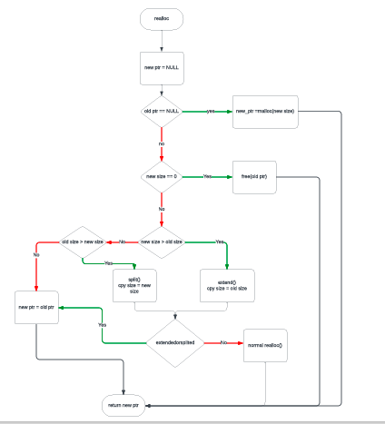

Slide 37
FUNCTIONS DETAILS
REALLOC_EXTEND_BLOCK
Purpose: Reallocates memory by extending the block.
Parameters:
ptr: Pointer to the previously allocated memory.
needed_size: New size of the memory block.
extend_split_flag: Flag indicating whether the block was extended or split.
Algorithm:
Extends the memory block if there is adjacent free memory available.
Performance Considerations: Depends on the size and structure of the free list.
Usage Examples: Used to resize memory blocks when reallocating memory.

Slide 38
FUNCTIONS DETAILS
REALLOC_SPLIT_BLOCK
Purpose: Reallocates memory by splitting the block.
Parameters:
ptr: Pointer to the previously allocated memory.
needed_size: New size of the memory block.
extend_split_flag: Flag indicating whether the block was extended or split.
Algorithm:
Splits the memory block if it is larger than the required size.
Performance Considerations: Depends on the size and structure of the free list.
Usage Examples: Used to resize memory blocks when reallocating memory.

Slide 39

Thank's For Watching
Thanks Eng Reda Maher.

